Slide 1


Code of Interdependence
The purpose of this presentation is to contribute to change by giving a brief overview of what we expect from ourselves and from our business partners in terms of sustainability.
The target groups are suppliers, employees as well as other people or companies that do business with us.
Whereas this presentation will give you an introduction, we expect our main suppliers to carefully read the entire Code of Interdependence
Notes:
Yhteistyömme ohjeistus, Code of Interdependence. Tämän esityksen tarkoituksena on saada aikaan Muutos !
Kerromme, mitä me –Chiesi- odotamme itseltämme ja yhteistyökumppaneiltamme kestävän kehityksen osalta.
Kohderyhmänä ovat tavarantoimittajat, henkilökunta, muut ihmiset ja muut yritykset.

Slide 2
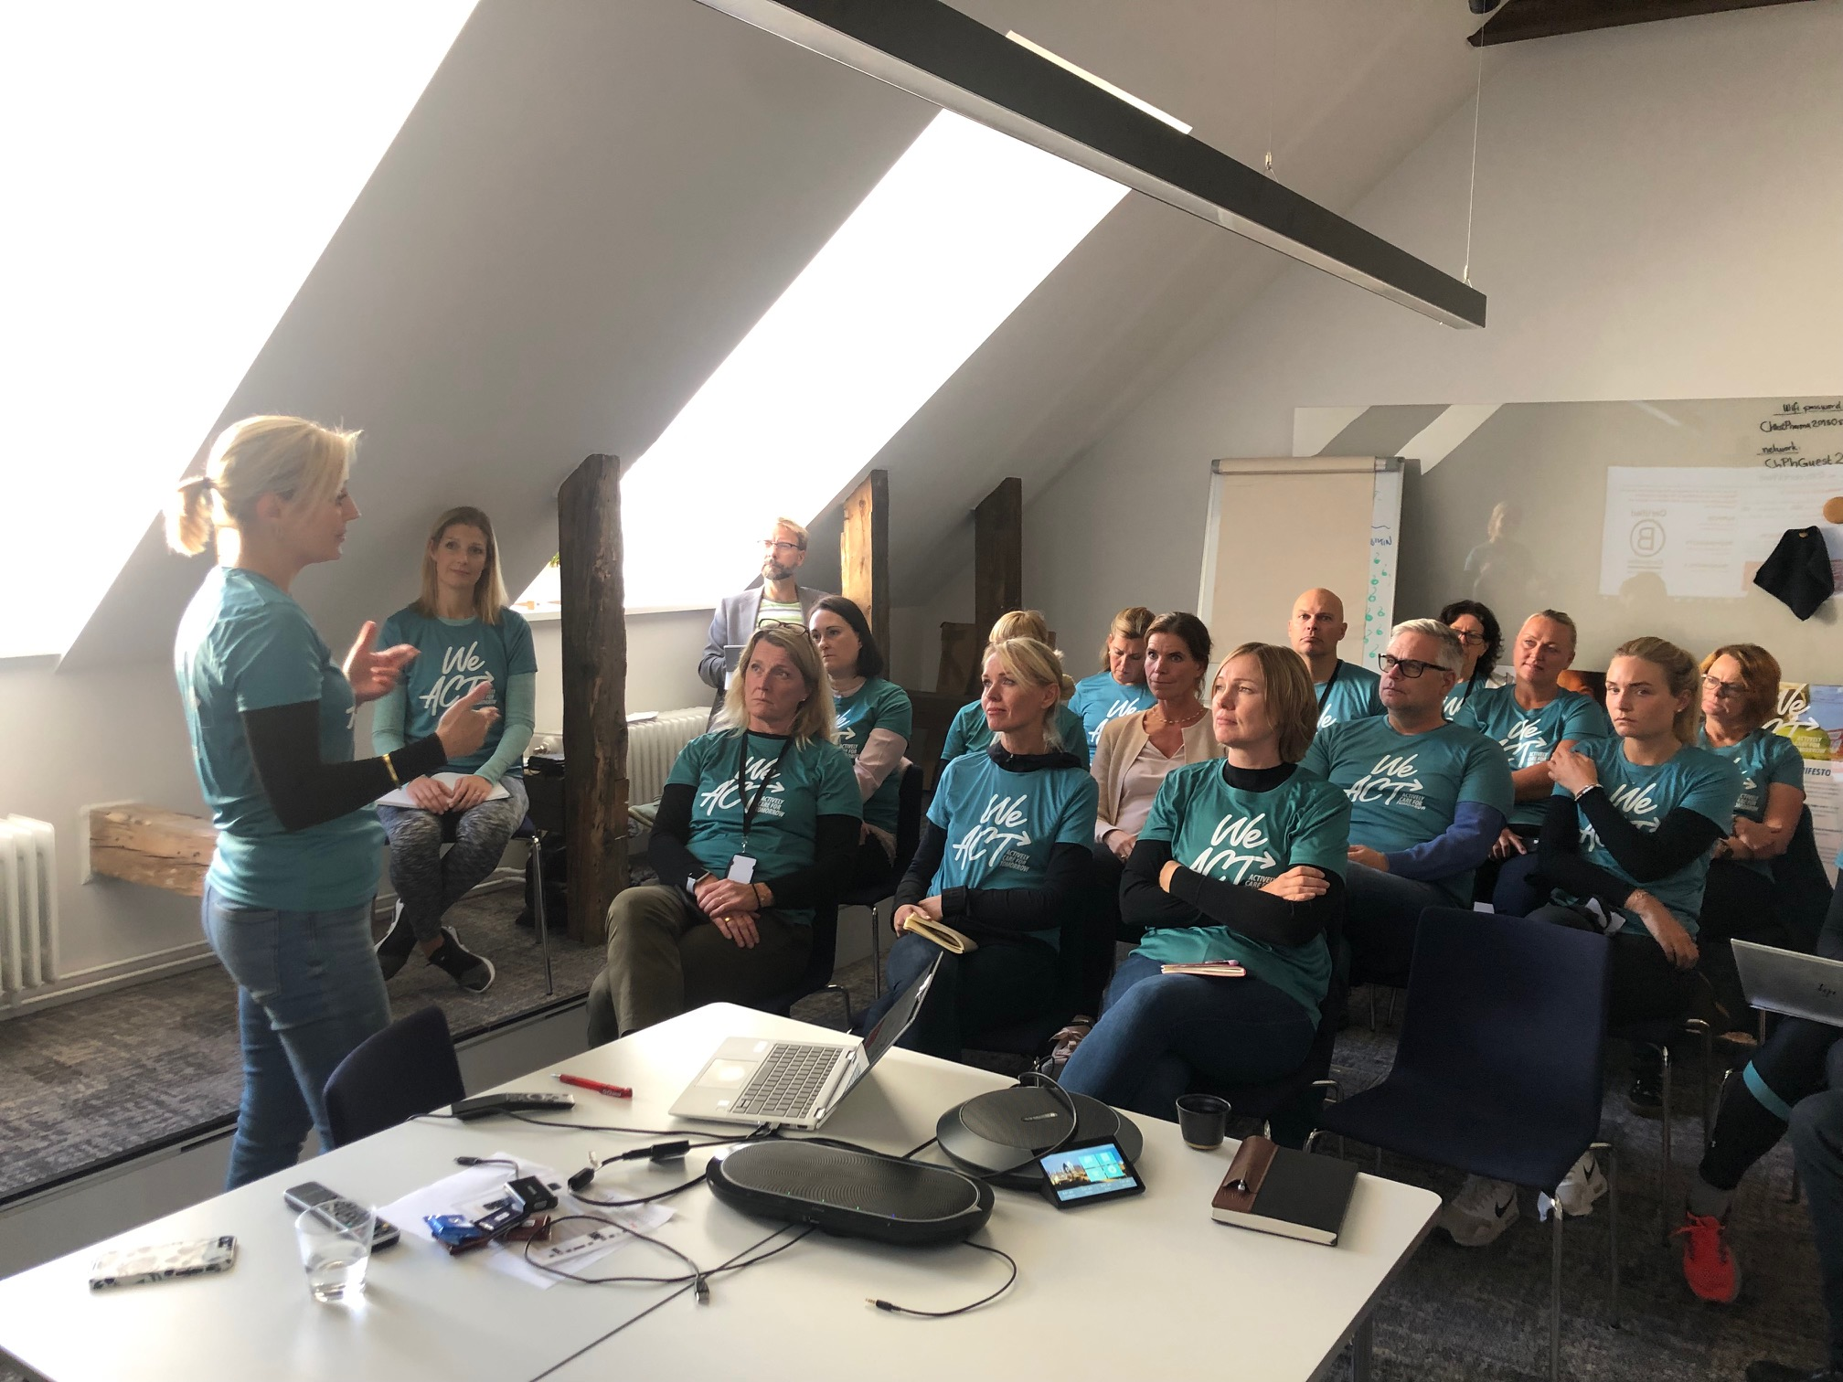
A Code on Sustainability for Chiesi and its Partners
Chiesi have decided that we want to be part of the solution, not the problem.
We want to inspire others and learn from the best.
The 2030 Agenda for Sustainable Development is our roadmap and our B-Corp certification a tool that helps us stay on the path.
Notes:
Kestävä kehitys Chiesillä ja yhteisyökumppaneillamme.
Chiesi haluaa olla osana ratkaisua, ei ongelmaa.
Haluamme inspiroida muita ja oppia itse parhailta. ”Agenda 2030 kestävään kehitykseen” on meidän tiekarttamme ja saavuttamamme B –Corp –sertifikaatti on työkalu tähän tavoitteeseen pääsyssämme.

Slide 3
Code of Interdependence
Our Code of Interdependence is a set of values, objectives and tools that comes from the collaboration within Chiesi and the companies that are part of our Ecosystem.
Through the Code we recognize how necessary and urgent it is to act, with the awareness that each of us is indispensable to the other and that we are all responsible for future generations.
Notes:
Yhteinen ohjeistuksemme on tarkoitettu sekä Chiesille että yhteistyötä kanssamme tekeville yhtiöille. Katsotaan seuraavaksi, kuinka kiireellistä ja välttämätöntä meidän kaikkien on toimia muistaen vastuumme tuleville sukupolville.

Slide 4

Chiesi Sustainability Vision
Our aspirations are based on the values TRUST, QUALITY, FAIRNESS, ACCOUNTABILITY and TRANSPARENCY.
We have let ourselves be inspired by the B Corp movement, United Nations SDGs and ILO, and finally by the industry specific PSCI initiative.
Our requirements and improvement actions are classified according to the relevant SDG and shall be implemented at minimum according to the national regulations and local laws. If the principles differ from national laws, the highest standard must be considered and applied.
As a partner of Chiesi we hope and expect that you share the values and aspirations in this presentation.
Together we can make a difference!
Note that there is a slight difference between the goals stressed in the Code and those in Chiesi’s Strategic Plan. The plan highlights SDG’s: 3,5,8,9,10,11,12,13 and 17.
Notes:
Chiesin kestävän kehityksen visio, jonka perustana ovat arvomme luottamus, laatu, oikeudenmukaisuus, vastuullisuus ja läpinäkyvyys.
B Corp –sertifioituna yrityksenä seuraamme YK:n, ILO:n ja Lääketeollisuusliiton ohjeita.
Kuvassa näkyvästä YK:n kestävän kehityksen tavoitteista olemme valinneet 9 keskeisintä (3, 8, 9, 10, 12, 13, 15, 16, ja 17), jotka seuraavaksi esitellään.

Slide 5

We support Goal 3: Good Health and Well-being
For us that means that we expect high levels of PRODUCT SAFETY, QUALITY COUNTRY REGULTIONS (i.e. that systems are in place to ensure that applicable laws, industry regulations etc. are followed) and TRAINING and CAPACITY BUILDING to reach the goals of the Code.
For more specific information as well as information about our improvement areas, please see the Code of Interdependence
Notes:
Tavoite 3: Hyvä terveys ja hyvinvointi.
Meille Chiesillä nämä tarkoittavat korkeatasoista tuoteturvallisuutta, maan lakien ja lääketeollisuuden sääntöjen noudattamista sekä jatkuvaa koulutusta.

Slide 6

We support Goal 8: Decent work and economic growth
We expect, from ourselves and from our partners:
Fair working conditions, fair working hours, time off and leave
Fair wages and benefits. We shall pay for overtime, not withhold salaries or benefits as intimidation and pay our workers on time
Not to use child labor in any form and young workers (above minimum age) must not carry out work that hinders their education or health
That we avoid inhumane treatment and we envision an environment free of harassment and abuse, including establishing complaint mechanisms for employees
For more specific information as well as information about our improvement areas, please see the Code of Interdependence
Notes:
Tavoite 8: Oikeudenmukainen työ ja taloudellinen kasvu.
Odotamme itseltämme ja yhteistyökumppaneiltamme oikeudenmukaisia työolosuhteita, työn ja vapaa-ajan tasapainottamista ja sovittua palkkausta. Emme kaytä lapsityövoimaa, mielestämme lasten kuuluu käydä koulua ja opiskella. Arvomme kieltävät kaiken epäinhimillisen kohtelun.

Slide 7
We support Goal 8:continued
Workers protection, occupational health and safety, emergency plans. Prohibition of “modern slavery” (incl human trafficking)
Freedom of association (forming and joining labor unions, communicate with management etc.)
Implementation of system or processes for risk management and business continuity
Process safety (e.g. to prevent catastrophic releases of chemicals)
For more specific information as well as information about our improvement areas, please see the Code of Interdependence
Notes:
Tavoite 8 jatkuu:
Työturvallisuus, työterveyshuolto ja pelastussuunnitelmat. Ihmiskauppaa ei suvaita ja se estetään. Yhdistystoimintaan voi vapaasti kuulua.
Työntekijät osallistuvat riskien hallinnan ja turvallisuussuunnitelmien tekoon.

Slide 8

We support Goal 9: Industry, innovation and infrastructure
We expect, from ourselves and from our partners:
scientific research and the development of technological capabilities
For more specific information as well as information about our improvement areas, please see the Code of Interdependence
Notes:
Tavoite 9 lääketeollisuus, innovaatiot ja infrastruktuuri käsittelevät tieteellistä tutkimusta ja teknologian hyödyntämistä.

Slide 9

We support Goal 10: Reduced Inequalities
We expect, from ourselves and from our partners:
Inclusion and diversity policies as well as implementation of programs to support inclusion in the workplace, from a cultural, capacity building and human relationship point of view
That we ensure equal opportunities and non-discrimination. We shall apply freedom from discrimination and equal opportunities to all stages, from the recruitment process, to working conditions, remuneration, professional development, promotion, contract termination and reporting of issues. All decision regarding the professional status of an employee should be based on ability, merit and performance.
We shall investigate complaints with a formal unbiased and fair process and take corrective action if needed.
For more specific information as well as information about our improvement areas, please see the Code of Interdependence
Notes:
Tavoite 10: Eriarvoisuuden vähentäminen sisältää kaikenlaisesta syrjinnästä vapaata työskentelyä eri taustoista tulevilla ihmisillä. Tavoitteena on ihmisten uralla eteneminen puhtaasti omilla ansioillaan ja epäoikeudenmukaiseen kohteluun puututaan tehokkaasti.

Slide 10

We support Goal 12: Responsible consumption and production
We shall put in place processes and waste disposal that do not harm the environment and we should have systems in place to ensure the safe handling, movement, storage, disposal, recycling, reuse or management of raw materials and waste as well as abate air emissions.
We are committed to the responsible use of chemicals.
We shall have systems in place to ensure the safe management of wastewater discharges.
We act in an environmentally responsible manner and we shall limit the use of energy, scarce resources and natural resources subject to continuous impoverishment (as clean water, wood, etc).
For more specific information as well as information about our improvement areas, please see the Code of Interdependence
Notes:
Tavoite 12: Vastuullinen kulutus ja tuotanto.
Rakennamme prosessit ja jätehuollon ympäristöystävällisiksi. Valmistus, varastointi, logistiikka ja kierrätys suunnitellaan vähäpäästöisiksi.
Vastuullisen kemikaalien käytön lisäksi satsaamme jätevesihuoltoon, huolehdimme ympäristönsuojelusta ja pyrimme energiansäästöön.

Slide 11
We support Goal 12: Responsible consumption and production
We shall be open to share our environmental impacts through communication tools and information exchange.
We shall inform Chiesi transparently of any problems or difficulties in applying this code of conduct.
We shall be available for external audits from Chiesi, or any other third party on behalf of Chiesi, in order to verify the compliance with and implementation in practice of the principles reported in this document. We shall work together to optimize the audits of our activities, facilities or laboratories through a transparent and continuous exchange of information. We generate clear and shared procedures and concrete application guidelines
For more specific information as well as information about our improvement areas, please see the Code of Interdependence
Notes:
Tavoite 12 jatkuu.
Viestimme omasta ympärisövaikutuksestamme ja kerromme läpinäkyvästi omasta toiminnastamme.
Käytämme ulkopuolista auditoijaa takaamaan oman toimintamme oikeellisuuden.

Slide 12

We support Goal 13: Climate Action
We shall have systems in place to map, monitor and manage all emissions in a transparent manner
We shall gradually reduce our carbon footprint to actively reduce global adverse climate impacts, limiting as much as possible the use of energy and scarce resources
For more specific information as well as information about our improvement areas, please see the Code of Interdependence
Notes:
Tavoite 13: Ilmastotoimet
Meillä tulisi olla järjestelmät kaikkien päästöjen kartoitukseen,seurantaan ja käsittelyyn läpinäkyvästi.
Vähennämme asteittain hiilijalanjälkeämme´, energiankulutustamme ja luonnonvarojen käyttöämme.

Slide 13

We support Goal 15: Life on Land
We shall prevent and mitigate accidental spills and releases to the environment.
We respect animals. All companies conducting animal testing shall promote animal welfare, by ensuring that all animals under their care have access to food, water, adequate accommodation etc.
We shall identify, address and mitigate any risk related to the mining of minerals originating from regions at high risk.
For more specific information as well as information about our improvement areas, please see the Code of Interdependence
Notes:
Tavoite 15: Elämä maapallolla.
Pyrímme ennaltaehkäisemään ympäristövahingot.
Huolehdimme koe-eläinten hyvinvoinnista.
Emme käytä epäeettisesti louhittuja mineraaleja.

Slide 14

We support Goal 16: Peace, Justice and strong institutions
We shall act with integrity and conduct our business in an uncompromised ethical way.
We shall declare promptly and in a clear way any conflict of interest that may affect the business.
We shall have mechanisms to track employees or community complaints or non-compliance issues against internal and external obligations and commitments that are previously investigated and solved.
We shall comply with all applicable environmental regulations
We shall design and implement a set of comprehensive internal policies and procedures for managing all relevant environmental issues
For more specific information as well as information about our improvement areas, please see the Code of Interdependence
Notes:
Tavoite 16. Rauha, oikeus ja vahvat instituutiot.
Toimimme eettisesti ja tiedotamme selkeästi toimintaamme liittyvistä asioista.
Käsittelemme sisäiset ja ulkoiset valitukset omien järjestelmiemme kautta.
Toimimme kaikkien ympäristönormien mukaisesti.
Suunnittelemme ja implementoimme sisäiset toimintamallimme ympäristönormien mukaisiksi.

Slide 15
We support Goal 16: Peace, Justice and strong institutions
We do not except or pay bribes or other inappropriate financial or material resources.
We shall implement a fair and ethical system of hiring
We shall provide to our employees a written copy of their employment contract or letter
We shall protect the privacy of our company, employees, patients, or any collaborator by safeguarding and make proper use of all confidential information in our possess.
For more specific information as well as information about our improvement areas, please see the Code of Interdependence
Notes:
Tavoite 16 jatkuu.
Emme ota vastaan lahjuksia emmekä anna lahjuksia
Rekrytoimme eettisesti ja oikeudenmukaisesti.
Annamme aina työntekijöillemme kirjalliset työsopimukset.
Tietosuojamme kattaa yhteistyökumppanimme, työntekijät ja potilaat.

Slide 16

We support Goal 17: Partnerships for the Goals
We shall broaden the perimeter of application of the Code of Conduct by influencing our suppliers and Ecosystem to implement the principles described above. The purpose is to ensure that suppliers of products and services also can initiate a program and live up to the principles in responsible sourcing standards.
Chiesi suppliers are required to inform their own suppliers of products and services on Chiesi standards set out in the Code of Conduct. Chiesi shall likewise ensure that suppliers of products and services meet these standards.
We shall effectively communicate the principles of the Code to our employees.
For more specific information as well as information about our improvement areas, please see the Code of Interdependence
Notes:
Tavoite 17. Yhteistyökumppanimme.
Haluaisimme kaikkien yhteistyökumppaniemme toimivan edellä kuvattujen tavoitteiden mukaan. Samoin toivomme heidän viestivän eteenpäin omille yhteistyökumppaneille tavoitteemme.
Tulemme kouluttamaan omat työntekijämme näiden tavoitteidemme osalta.

Slide 17

Conclusion
Thank you for your attention!
If you want to have more details or if there is anything in this presentation that you don’t understand, please read the Code of Interdependence or talk to anyone at Chiesi. Likewise if you disagree or can’t comply with the aspirations presented in this presentation or in the Code you also need to contact Chiesi to discuss further.
Sustainability isn’t always easy – that’s why we must cooperate and learn from each other!
Notes:
Yhteenveto.
Kiitos mielenkiinnostanne.
Jos haluatte lisätietoa, löydätte sitä osoitteesta Code of Interdependence tai kysymällä Chiesin edustajilta.
Jos haluatte antaa palautetta, ottakaa yhteyttä Chiesiin.
Kestävä kehitys ei ole aina helppoa-
siksi meidän on tehtävä yhteistyötä ja opittava lisää toisiltamme !

Slide 18










Sustainability plan for Chiesi Nordic 2020-22
PLANET
Goal 5. Demand and encourage suppliers to commit to sustainability best practice
Goal 6. Ensure high work-place well-being
Goal 7. Encourage continuous learning and improvement
Goal 8. Reduce risk of irregularities at Chiesi Nordic
Goal 9. Use company resources and strengths to improve well-being of others
Goal 1. Reduce CO2 emissions by at least 40% per employee between 2019-2022
Goal 2. Adopt a more circular approach to consumption
Goal 3. Ensure that Chiesi products benefit those in need of them
PEOPLE
PATIENTS
PARTNERSHIP
Goal 4. Inspire other pharmaceutical companies to improve their sustainability work
Notes:
These are Chiesi Nordics Sustainability goals 2020-2022. They are grouped according to 4 focus areas that Chiesi has: Planet, Patients, Partnership and People

Slide 19
A call for Action!
Digital signatures Transparent intranet
More electric vehicles Inform about B-Corp!
Update agreement templates Tips & Tricks
More video conference – less flying
Reward sustainable innovations! Plan our sales trips better
Offer our skills to those who need them
Serve climate smart lunches Equality of benefits
Influence others! Follow-up meetings on Skype
Make our products available to those who need them Investing our pension funds sustainably

